Slide 1
Human Rights of India
Presented By- Adithi and team…

Slide 2
Table of Contents
1
2
3
4
8
Right to marry and have a family
Human rights
9
Right to work
Right to democracy
10
Right to life
No slavery
11
No discrimination
Right to own things
5
12
Right to privacy
Right to education
13
All are equal before the law
6
Freedom of speech and expression
7
14
Human rights cant be taken away
Right for trial

Slide 3
Human Rights…

Slide 4

Human rights…
“First they ignore you
Then they laugh at you
Then they fight you
Then you win” -Mahatma Gandhi
Human rights is moral principles or norms that describe certain standards of human behavior, and are regularly protected as legal rights in municipal
and international law. Everyone born in this world have human rights that must be protected by the law.

Slide 5
Right to Work…

Slide 6
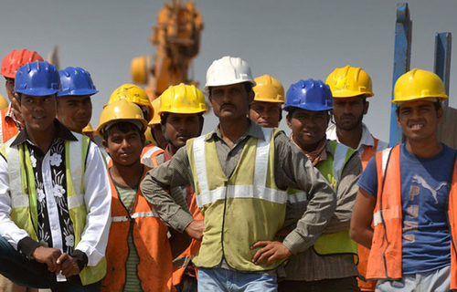
Right to work…
What is a Right to Work law? A Right to Work law guarantees that no person can be compelled, as a condition of employment, to join or not to join, nor to pay dues to a labor union. Section 14(b) of the Taft- Hartley Act affirms the right of states to enact Right to Work laws.

Slide 7
No Slavery…

Slide 8
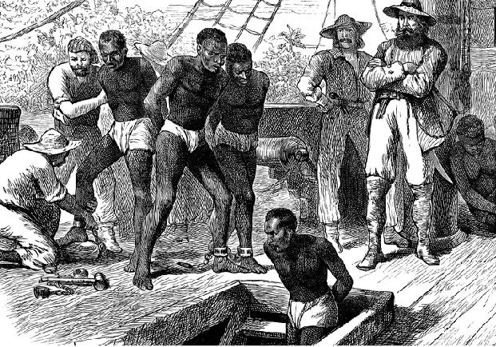
No slavery…
Article 4 protects your right not to be held in slavery or servitude, or made to do forced labor. Slavery is when someone actually owns you like a piece of property. Servitude is similar to slavery - you might live on the Person premises, work for them and be unable to leave, but they don't own you.

Slide 9
Right to Own Things…

Slide 10

Right to own things…
Everyone has the right to own property alone as well as in association with others. No one shall be arbitrarily deprived of his property.
1.Scarce physical resources such as houses, cars, books, and cellphones.
2.Non-human creatures like dogs, cats, horses or birds.
3.Intellectual property such as inventions, ideas, or words.

Slide 11
Right to Education…

Slide 12

Right to education…
Everyone has the right to education. Education shall be free, at least in the elementary and fundamental stages. Elementary education shall be compulsory. Technical and professional education shall be made generally available and higher education shall be equally accessible to all on the basis of merit.
Article 21-A of the Constitution of India lays down the rules and regulations to be followed to ensure the right to education

Slide 13
Freedom of Speech and Expression…

Slide 14

Freedom of speech and expression…
Freedom of opinion and expression includes the freedom to hold opinions without any interference and to seek, receive and impart information and ideas through any media and regardless of frontiers. This means that you can think, express and share anything you want without any hesitation.
.

Slide 15
Right to Trial…

Slide 16

Right for trial…
Now, the right to trail tells that anyone and everyone has the right to hold a trial against any criminal charges against him. This means that if a criminal charge is filed against a person, he has the right to hold a trial against that charge.

Slide 17
Right to Marry and have a Family…

Slide 18
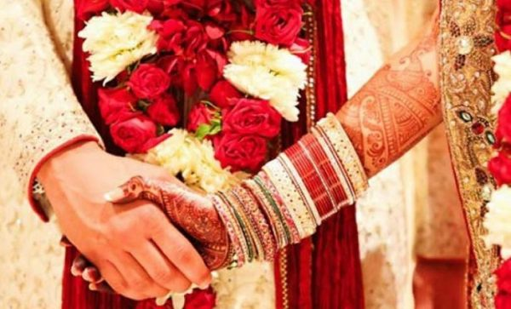
Right to marry and have a family…
Men and women of full age, without any limitation due to gender, race, nationality or
religion, have the right to marry and to finnd a family. They are entitled to equal rights as to
marriage, during marriage and at its dissolution.

Slide 19
Right to Democracy…

Slide 20

Right to democracy…
Everyone has the right to take part in the government of his country, directly or through freely chosen representatives. Everyone has the right of equal access to public service in his country.

Slide 21
Right to Life…

Slide 22

Right to life…
According to Article 21: “Protection of Life and Personal Liberty: No person shall be deprived of his life or personal liberty except according to procedure established by law.” This fundamental right is available to every person, citizens and foreigners alike.

Slide 23
No Discrimination…

Slide 24

No discrimination…
Discrimination is the act of making unjustified distinctions between human beings based on the groups, classes, or other categories to which they are perceived to belong. People may be discriminated on the basis of race, gender, age or sexual orientation, and other categories.
The principle of non-discrimination seeks “to guarantee that human rights are exercised without discrimination of any kind based on race, colour, sex, language, religion, political or other opinion, national or social origin, property, birth or other status such as disability, age, etc :

Slide 25

Right to Privacy…

Slide 26

Right to privacy…
On 24 August 2017, the Supreme Court of India in a historic judgement declared the right to privacy as a fundamental right protected under the Indian Constitution. Union of India has declared that the right to privacy is a fundamental right protected under Part III of the Constitution of India. This is the right to be left alone. Right to privacy is basically Right to life and personal liberty under Article 21 of the Indian Constitution.

Slide 27
All Equal before Law…

Slide 28
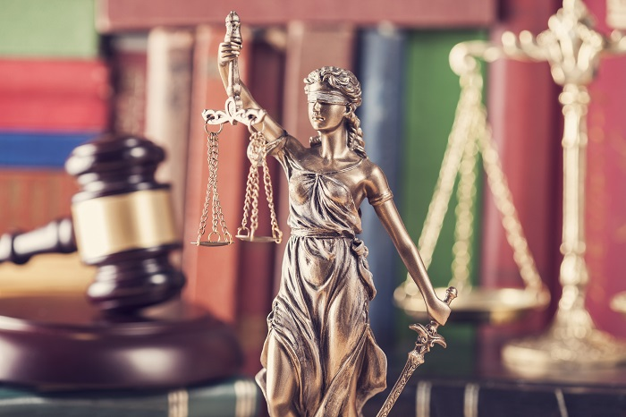
All are equal before law…
All are equal before the law and are entitled without any discrimination to equal protection of the law. All are entitled to equal protection against any discrimination in violation and against any incitement to such discrimination.

Slide 29
Human Rights can’t be Taken Away…

Slide 30
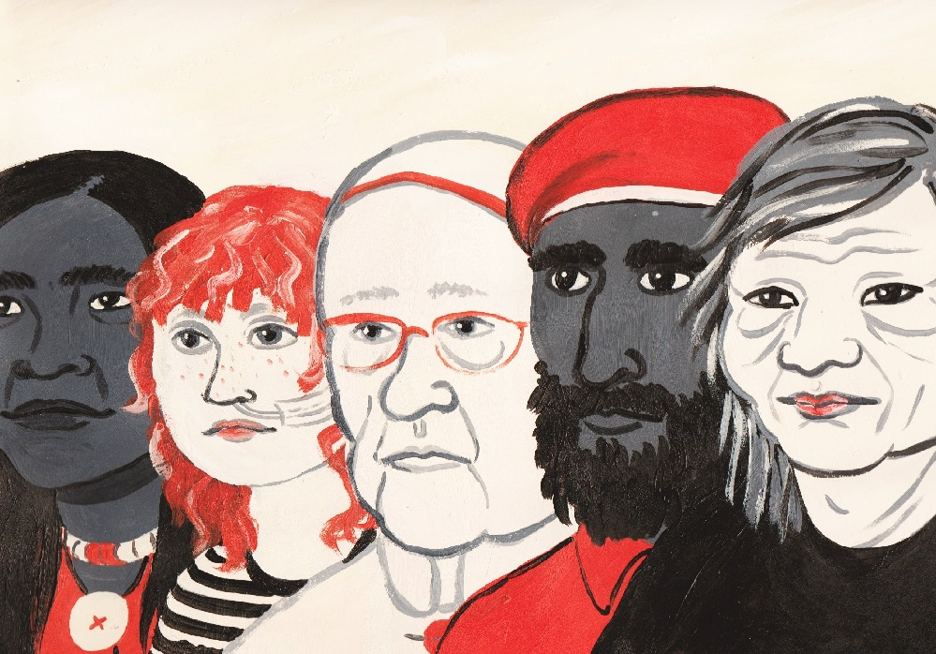
Human rights cant be taken away…
Nothing in this Declaration may be interpreted as implying for any State, Group or person any right to engage in any activity or to perform any act Aimed at the destruction of any of the rights and freedoms set forth herein.
Human rights are inalienable. They should not be taken away, except in specific situations and according to due process. For example, the right to liberty may be restricted if a person is found guilty of a crime by a court of law.

Slide 31
A video…
https://youtu.be/pRGhrYmUjU4

Slide 32
Team Members
Team Leader
Adithi
Written work by-
Sanketh
Dhwani
Prajukthi
Umesh
Khushi
Nayana
PPT by-
Manasi
Others-
Tanishq
Dino
Gouri Shankar
Preetam
Chetas
Haadiya
Thanks!

Slide 33
Copyright
Google, Wikipedia and Britannica

Slide 34
Alternative Resources

